Slide 1
Wednesday, Jan. 7, 2015
You need your journal.
Bell Ringer: Write a three sentence description of where the Snowman is in our room…

Slide 2
Prepositions
http://www.youtube.com/watch?v=yfExXGMX2JM

Slide 3
Prepositions and Prepositional Phrases
Starting Activity: Write a three sentence description of where the Snowman is in our room…

Slide 4
What are Prepositions?
Prepositions are words that tell you the location of something in space, time, direction or possession.
What does that mean???
They tell you where something is, when something happened , what something is near or who it belongs to.
Prepositions must have objects to be prepositions!

Slide 5
Prepositions by themselves
Are actually adverbs!!
Example:
They ran out.
Out is a preposition, but it doesn’t have an object, so it is actually an adverb!
They ran out the door.
This is a preposition because it has an object to “run out”

Slide 6
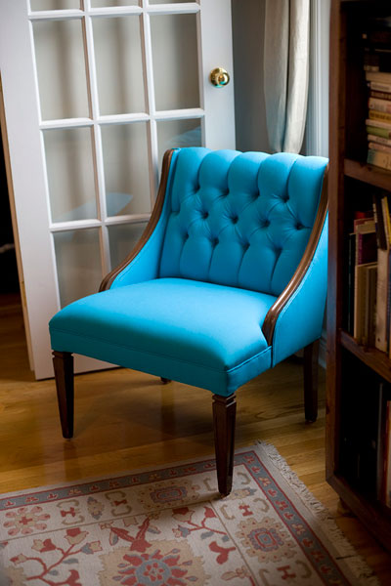
Prepositions of Place/Location
By, beside, between, near, under, over, inside, outside, above, below, behind…
Examples:
The chair beside the door is blue.
Place the book beside the others.

Slide 7
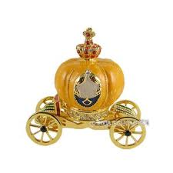
Prepositions of Time
Before, after, in, at, on,
during
Examples:
Before the party, you should clean your room.
The coach turns back into a pumpkin at midnight.

Slide 8
Preposition of Direction
To, on, in, into, onto, through
Examples:
You should run to the finish line.
Put your shoulder into your swing.

Slide 9
Prepositions of Possession
Of, for and to
Examples:
That friend of yours is hilarious!
I see the leaves of the tree through my window.
That shirt belongs to Sarah.

Slide 10
What is a prepositional phrase?
The preposition and the words that follow a preposition make up the prepositional phrase.
The pattern is…
Preposition + noun, gerund or clause (sometimes there will be adjectives or adverbs to describe the noun or phrase)
The noun following the preposition is called the OBJECT of the Preposition.

Slide 11
Finding the Object
You can find the object of the preposition by asking “what” after the preposition.
Henry placed the book under the chair.
Under is the preposition, so we ask UNDER WHAT?
The answer, chair, is the object!

Slide 12
Where is that object?????
If there is a “preposition” with no object, it is actually an adverb…
Please finish up. (up has no object, so it is an adverb)
He put the book down. (down doesn’t have an object, so it also is an adverb)

Slide 13
Examples of Prep Phrases
Like:
Under the palm tree you will see a coconut.
The preposition is under….Under what? The palm tree…So the Prepositional Phrase is under the palm tree. Prep plus adjectives and object
She amazed us with her magic trick. The preposition is with…With what? trick, her trick…So, the Prep Phrase is with her magic trick. Prep plus modifier and object

Slide 14
Find the Prepositional Phrases…
1. Beside the shelf you will see the trash can.
2. You can have a snack after Paul.
3. The puppy ran into the dog house.
4. The door of the house was open.
5. The book you need is between those two.
6. Put the shoes under the chair.

Slide 15
Let’s Practice!
http://www.softschools.com/quiz_time/language_arts/preposition/theme156.html
http://www.quia.com/quiz/298373.html?AP_rand=1576095099
http://quizzes.cc/the-preposition-quiz-237

